Slide 1
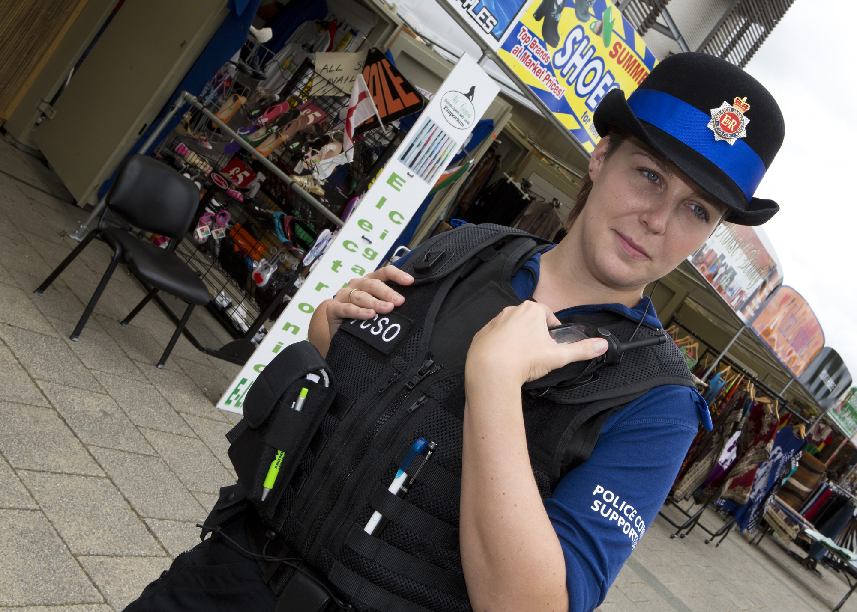
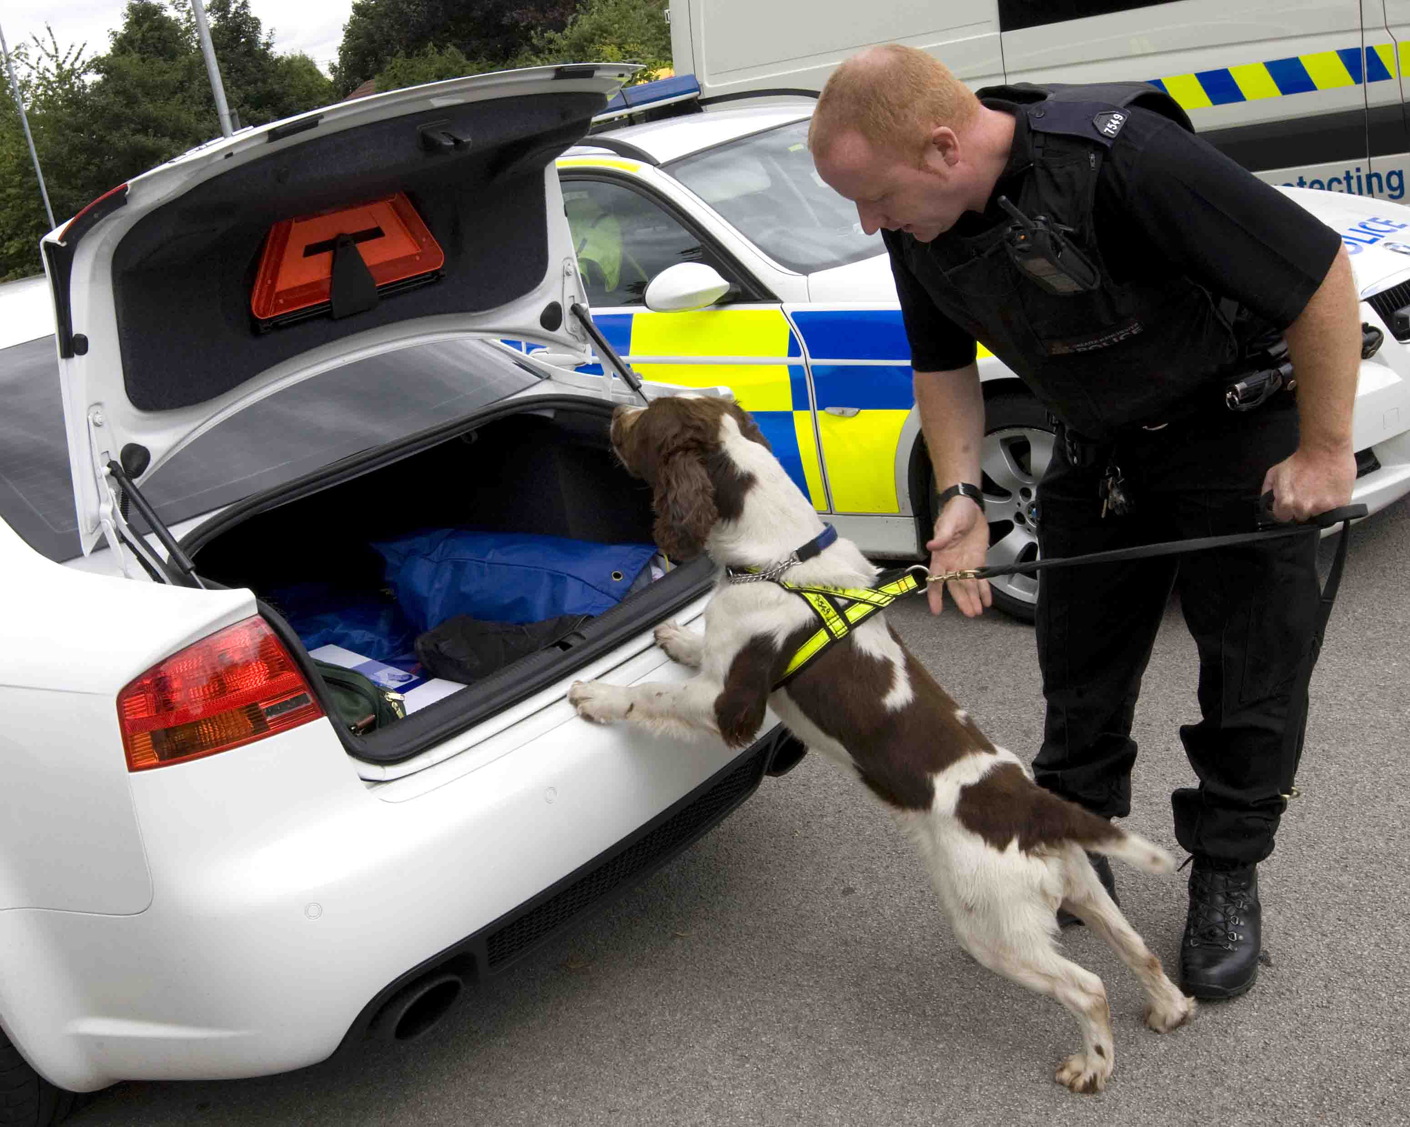
MANCHESTER
SECURITY 2018
Event sponsors:

Slide 2
Paul King
Chairman
MCCCPP
Event sponsors:

Slide 3
Russ Jackson QPM
Assistant Chief Constable
Greater Manchester Police
Event sponsors:

Slide 4
Baroness Ruth Henig
Chair
SecuriGroup
Event sponsors:

Slide 5
4
Cherie Buttle
Chief Inspector
Greater Manchester Police
Event sponsors:

Slide 6
4
Insp Jon Middleton
Insp Jon Adams
Greater Manchester Police
Event sponsors:

Slide 7
MANCHESTER
SECURITY 2018
Event sponsors:

